Slide 1
CSS-1
Cascading Style Sheets

Slide 2
CSS so far….
CSS 1 (December 17, 1996)
CSS 2 (May 1998)
CSS 2.1 (June 7, 2011)
CSS 3 (Under Development)(Partially Adopted)
CSS 4 (Proposed)

Slide 3
CSS
CSS Rules
  Selector
  Declaration
    Property
    Value
    h1 { font-family : arial; }
Selector
Declaration
Property
Value

Slide 4
CSS Selectors
Element Selector : An HTML Element
    h1 {…}
    p {…}
ID Selector : An identifier unique to the document.
    #header {….}
    #footer {….}
Class Selector : An identifier that groups multiple elements in a document.
    .social {…..}
    .gallery {…..}
Notes:
Classes and IDs are case-sensitive.

Slide 5
CSS Styles
Inline Styles (Using style attribute)
Internal Styles (Using style element)
External Style Sheets (Using link element)

Slide 6
Inline Styles
Inline styles can be associated with any individual element.
Less common approach between designers require frequent editing, if design need to be modified.
Less feasible method.
<body style=“background-color : grey”>

Slide 7
Internal Styles
Internal Style Sheets can be used to group a set of CSS rules, which can thus be applied to all HTML element of specific type, any single element of any specific type.
Feasible for Large HTML document.
Internal Style Sheets can be defined/grouped inside the <style> element, which comes under the <head>.
    <head>
    <style>
    h1 { font-color : red; }
    </style>
    </head>
    *Apply to all h1 elements in the document.

Slide 8
External Style Sheets
External Style Sheets are separate CSS documents which contain all the common rules and styles that can be used across the entire website.
It offers a common look and feel for website elements by ensuring that all controls of a specific type look identical.
Best suitable for medium to large scale websites or applications.
External style sheets can be saved with *.css extension.

Slide 9
CSS Inheritance
It is one of the greatest feature of CSS.
In CSS any CSS rule which is specified for the topmost element in the document tree, will run down till the last element in the document, thus offers, all designers’ greater relief by not repeating rules which are common for all sub-elements.
Example of common attributes/properties
  font-color
  font-style
  margin
  Padding etc.

Slide 10
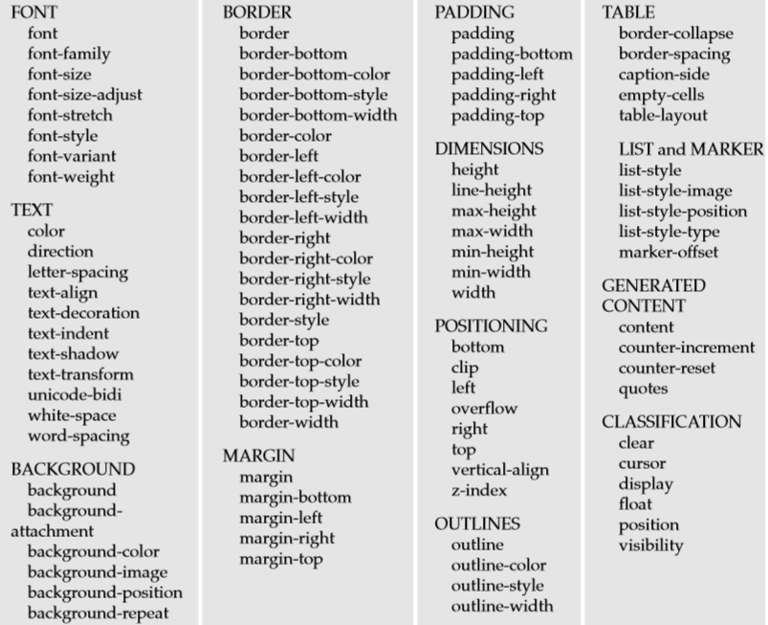
CSS Properties

